Slide 1
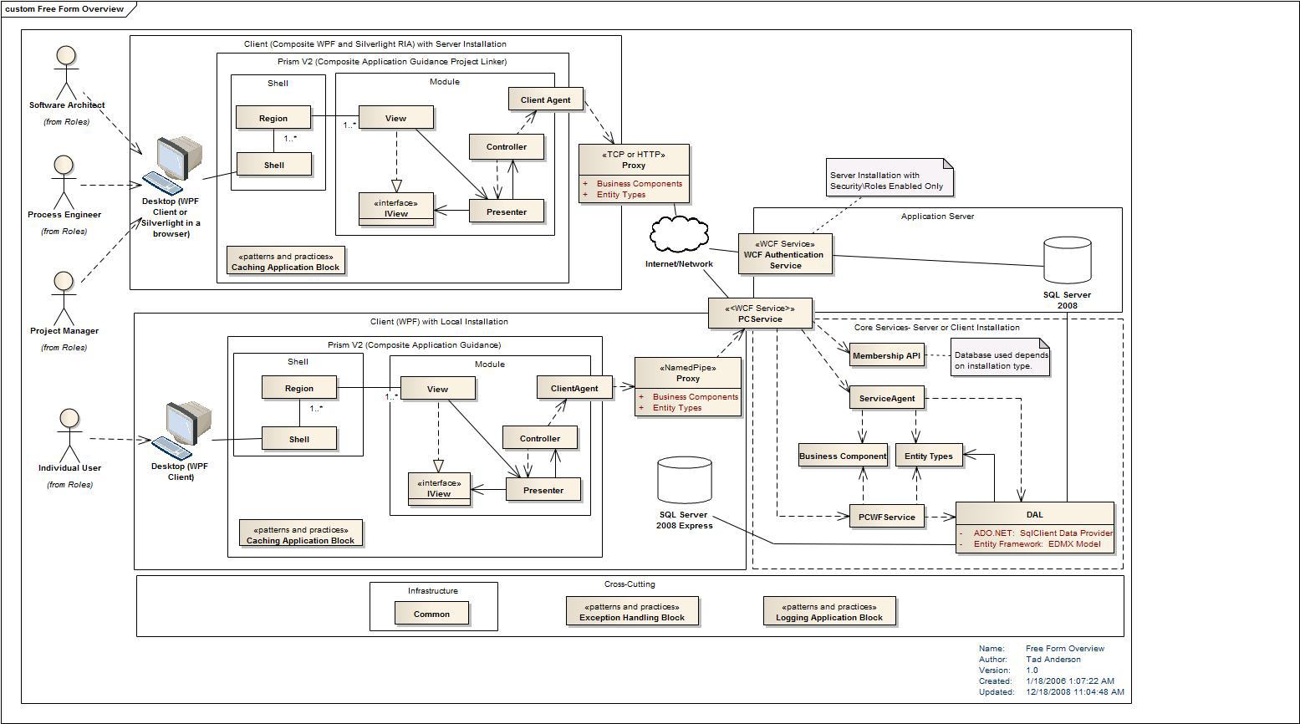



Microservice Architectures
What is it? Why does it matter?
Peter “Shawty” Shaw
Notes:
Welcome to DDD North, I hope your all having a great day so far.
As the title says where going to be talking about Microservice architectures in this session, first of all however (CLICK)

Slide 2
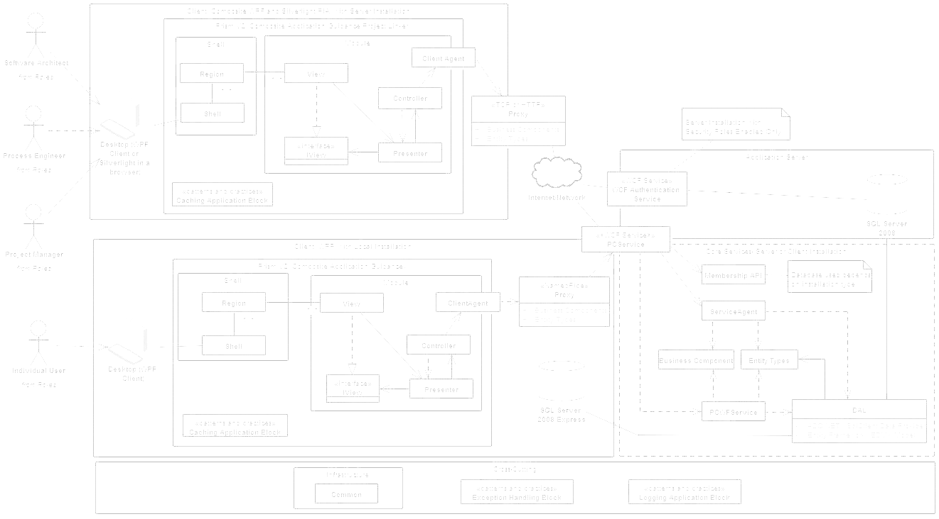
Who Am I
I’m the UK & Europe group manager for the Linked.NET Users group (Lidnug) a global .NET user group based on the Linked-In platform.
I’m a Pluralsight Author and one of the main Authors in the Syncfusion Succinctly Series of free EBooks
I’ve been doing I.T & Computing in one form or another since the early 1980’s and I pride myself on being one of the UK’s original back bedroom developers.
I now own & run Digital Solutions UK, offering consultancy & other I.T related services in the North East of England.

Slide 3
Who Am I (How to contact me)
You can find me on twitter as
@Shawty_ds
You can find me on Linked-In
https://www.linkedin.com/in/petershaw08
You can email me
Shawty.d.ds@googlemail.com

Slide 4
Session Agenda

Slide 5
Session Agenda
Define what a Microservice Architecture is
Benefits
Drawbacks
Explain why Owin & Katana have an important role to play
Lightweight Services
Platform Agnostic
Practical/Technical demonstration
Working Microservice Setup under IIS7
Tour of some Owin/Katana services & code
Notes:
Since we only have 60 minutes, this session won’t be particularly heavy on details.
As much as I’d love for it to be a deep dive I simply won’t have time to cover everything, we’ll use the first 30 minutes or so taking a fairly high level look at what the pattern represents and some of it’s benefits and drawbacks.
We’ll define what it’s attributes are, and look at some of the theoretical points surrounding it.
We’ll then move on to a quick overview of what Owin & Katana is, and how it fit’s into the microservices architectural pattern, and more importantly why you seriously need to be looking at using it.
Finally we’ll take a look at a ready made Visual Studio and IIS7 Solution that implements the pattern in a very basic form, where I’ll talk you through some of the code and techniques used to make it worth while.
Since I don’t have much time, if we could leave any Questions until the end of the session, and time permitting I’ll do my best to answer as many as I can.

Slide 6
What is a Microservice
Architecture?

Slide 7
What is a Microservice Architecture
It’s an architectural project design pattern
It’s a set of guidelines on which to base deployment choices
It’s already supported by EVERY server setup on the planet
It’s been around for a long time (or at least the concept has)
Notes:
Microservice architectures are a project level architectural design pattern, they are not as some might try to have you believe a software design pattern. Martin Fowler on his blog makes this mistake and tries to define “Microservice” as a modular concept at a single application level. While you can apply it in this manner (as we’ll see in just a moment) the concept is actually far more reaching than a singular application.
From a guideline point of view the Microservice pattern helps you decide what hardware/software you need to deploy and how, unlike the more traditional model where you map out the software architecture, build the initial model then performance test it to see what’s needed to run it. With the Microservice pattern you also get a lot of flexibility in those guidelines.
From a support perspective you don’t need anything special to deploy the Microservice Architecture pattern. Every web server based platform currently available has everything needed out of the box to make it work, and in the few cases where it’s not available out of the box it’s generally easy enough to add it after the fact.
It might surprise many that the pattern has been around for a very long time, and there’s a very high chance that you’ve used it without realizing. As a pattern, it’s concept has been hijacked and moulded into something that many of us already have first hand experience with and that’s the general SOA based pattern.

Slide 8
What is a Microservice Architecture
It’s the very opposite of the general purpose monolithic architectures we seem to use today
It makes scaling easier and more importantly, less costly
It’s separation of concerns over and above software level
It’s NOT platform specific
Notes:
Most of us developing software in .NET today will most likely be using ASP.NET MVC, MVC is a perfect example of a monolithic architecture, in so much that in most cases your controllers are all compiled into one single central web application, and while there exists methods to allow you to detach your controllers, many of these methods are often complex and error prone to implement.
One thing that will please most folks in here about the pattern however is it’s ability to changed dynamically with very little impact. Because of this scaling horizontally is also very easy AND (this ones for the business minded folks in here) costs on average, much less than scaling out an entire monolithic code base.
Because it’s a flexible architecture, EVRYTHING is layered. For those of you who practice n-tier in a monolithic MVC application, you can immediately go out and start using Microservices, simply by splitting your layers up into discrete layered projects that communicate using a loosely coupled, disjointed medium.
Finally, it’s not something that’s platform specific, if you have the ability to write web services on a platform or in a given language then that ability can be used in a Microservice deployment. Even a Linux shell script, sitting listening on a port via the command line Net-Cat tool can be used as part of a Microservice deployment.

Slide 9
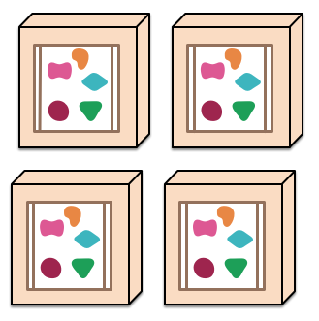
What does a Microservice Architecture
Look like?
First let’s see a monolithic architecture for comparison
Images borrowed from martinfowler.com
Notes:
So what does a Microservice Deployment look like. Before we answer that question let’s take a look at a typical monolithic architecture for comparison.
(Credit where it’s due, the diagrams I’m using have been borrowed from martin fowlers blog at martinfowler.com, if your interested in software architecture in anyway esp under .NET you should pay it a visit)
In a typical monolithic architecture we have a single server, that usually has all the parts required for our application to run, represented by the blue rectangle, and when we deploy, we typically push that entire single unit and everything else around it onto our hardware, often as a single monolithic entity, giving us one copy of the entire application landscape per server.
In the diagram we have 4 sub-units on 1 application server, which for many of you will most likely mean a single application deployed on 1 Microsoft Azure or Amazon EC2 instance, with 4 areas of separate functionality.
If your app is large then that deployment may take time, worse still if you have to add or update any functionality in the application, you have to take the entire app offline to update it.
This might not be a problem if you have multiple geographic deployments because you can easily take an instance down, replace it, then spin it back up, repeating the process for each of the other instances, but for a single app on a single server, this could mean downtime.
And what about scaling up, to meet demand? (CLICK) Usually we scale the entire server virtual machine, even if it is just to meet demand in a small part of the entire build, and believe me when you start scaling large server instances, the IOP’s, bandwidth and billing from various elastic services get’s very un-funny, very fast, I’ve faced bills of £9k from Amazon before.

Slide 10
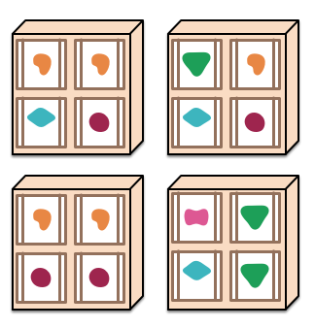
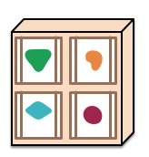
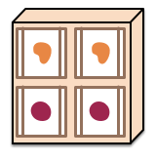
What does a Microservice Architecture
Look like?
Notes:
In a Microservice Architecture each module of functionality is different.
You may have a Module that handles accounting, one that handles sales and another that handles a catalogue.
Because each module/service is an independent entity, when we deploy our services out to our servers, we deploy only what we need to initially meet demand.
In the diagram on screen you can see that the deployments on each of the 4 servers are made up of singular pieces each with a specific function.
When we scale (CLICK) we only have to scale the individual smaller parts needed to fill that demand, as opposed to a large monolithic entity ,where only a small fraction of it may get used.
If we are asked to add extra functionality (CLICK) that’s just as easy too.

Slide 11
What does a Microservice Architecture Look like?
There’s no rules for how you deploy a functional module
How small you reduce a unit of functionality too is your decision
Notes:
How you build and deploy your sub modules is entirely up to you. On windows (as you’ll see in the demo) you might create them as stand alone windows services running in some kind of a container architecture such as docker.
Under Linux or Unix, you might have VM’s running under a hypervisor such as Xen and deploying as simple Daemons running independently of any other services.
How far you boil your applications functionality down is limited only by what resources you have available, and exactly what you want to achieve, I personally wouldn’t go any lower than a given leaf node in a rest URL, I have however seen some builds that almost go right down to individual controller level.
The smaller you break things down however, the larger your overall maintenance task is going to be, so there is always going to be a trade off between using this to increase your performance and increasing your workload.

Slide 12
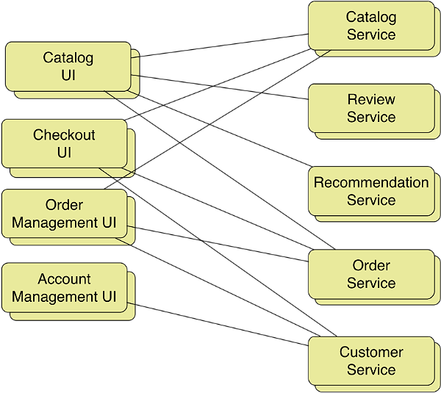
What does a Microservice Architecture
Look like?
/Account
/Account/Service
Notes:
Typically your break points should mirror functionality areas.
Often you’ll have one application platform that acts as a master and holds most of the UI and essential core operational parts, then you have some kind of URL re-writing mechanism that “re-directs” the leaf nodes in your application to the appropriate services.
(CLICK)
For example, the account management UI might live at ‘/Account’
(CLICK)
But the customer service might live at ‘/Account/Service’
To the end user, everything appears to be seamless, and from the outside actually looks like a single monolithic application with everything served off the same URL, under the hood however it’s an amazingly flexible and dynamic set up.

Slide 13
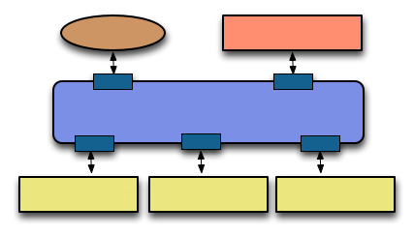
How do the modules/services communicate?
There are currently 2 common schools of thought.
External Client
Website Client
Enterprise Service Bus (e.g.: Redis or RabbitMQ)
Service Module
Service Module
Service Module
The Enterprise Service Bus Way
Notes:
Communication between the various modules is often the most hotly debated topic when designing a Microservice Deployment, and there are two main schools of thought here.
Many people have a preference for the Enterprise Service Bus way of doing things, where you have a central communications bus.
Messages are posted to this bus, and each of the services in the solution watches for messages they understand.
This is a good solid communication method, but it has one very big pain point that in many ways defeats some of what Microservices set’s out to achieve.
Your “Bus Component” presents a single point of failure, and if you loose your bus, you effectively loose the entire application. There’s nothing saying that you can’t load balance the “Bus Component” but if you have a correctly designed deployment, where you’ve gone to great lengths to ensure that functionality is independent enough to “Stay Running” even if some components fail, then having a central BUS is not the correct strategy to use overall.

Slide 14
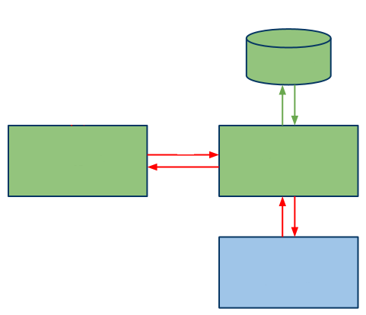
How do the modules/services communicate?
There are currently 2 common schools of thought.
Database
Native
JSON
Website Client
Rest API
JSON
External Service
The Restful/HTTP way
Notes:
The second generally accepted way is via a restful based JSON interface.
In this scenario, your “Web Based Application” is very often just a simple static user interface, which in many cases is not even server rendered by something like ASP.NET Mvc, but rather is just a simple collection of plain old HTML pages using something like Knockout, Angular, Drundal or many others to template it’s data in via the use of MVVM and ajax calls.
An individual area of functionality would in this scenario present it’s own restful api, generally rendering nothing except pure data. This data can be generated from a Database, an external service or many other sources available to the service.
This for many seems to be the more accepted way, especially when deployed to applications which change frequently or have high scaling needs, as it means that individual parts can easily be swapped out as needed without having to remove dependencies also.
Some deployments even use both methods, with a large group of back end services sharing data via an ESB, but with the UI layers communicating to a common facade which then connects to these services via the ESB solution.
One thing that is apparent in this setup, is that it’s generally considered bad practice to deliver render-able HTML and UI elements from any of the API’s presented by the services. That’s not to say it can’t be done, but it’s generally frowned upon if HTML is produced anywhere else except from the frontend application layer.

Slide 15
Benefits of a Microservice Architecture
Loosely coupled application teams rather than divided teams with specific technical silos.
Think of your own team, do you actually involve your DBA’s and maintenance guys in your development cycle?
Applications have a modular structure
It’s all about flexibility and changing business needs
Things are pluggable
If you have ANY experience with Linux/Unix then think about ‘pipes’ and chaining commands together
Notes:
So what of the overall benefits?
Some of the many benefits that a Microservice deployment will bring you are, Loosely coupled teams.
When was the last time you involved your DBA’s, UI Designers, Managers, Domain Specialists and other key players on a project in your development efforts?
If your anything like most teams, I can guarantee the answer is pretty much NEVER. If you think about it though, ALL of these people have key bits of information that are crucial to your applications ongoing health, with “application” groups no more do you have the “Throw it over the wall for the next team” syndrome
Because your applications are modular, you can now have specialist teams that look after the “Accounts Module” or the “Shopping Service”, if the business needs a “Widget Manager” adding, they can easily build a team that has experience building “Widget Managers”, this team can develop the application in isolation quite easily then simply “connect” it to the live site when it’s fully tested and working, without causing any problems to the already live application.
Likewise, old modules that are no longer relevant can just as easily be pruned and removed.
Things are “Pluggable” and “Chainable”, which means you can easily connect 2 or more services together to act as a processing pipeline. You might for example have a service that retrieves a list of “Do Dah’s” from the product catalogue, that list may be requested by a customer preferences service which has knowledge of a customers favourite colours and can then filter the list to only include the ones the customer will most likely buy.
If you have any experience with Linux or Unix systems or general console based environments then you’ll very likely understand straight away the process I’m describing here.

Slide 16
Drawbacks of a Microservice Architecture
Potentially higher maintenance cost
Because things are more spread out, possibly over different platforms maintenance is going to be fraught with more problems and potential costs
Data Islands
Data can easily get disjointed, simply because of the unique nature of the architecture.
Monitoring
For a successful service deployment, monitoring is ESSENTIAL, dashboards monitoring every aspect of every service must be in place to notify you of every metric.
Notes:
Don’t be fooled however, it’s not all pretty colours and flower gardens, some of these plants have thorns on them.
Maintenance costs are going to be higher, especially at the IT-Pro and server admin end of the scale. Because you have so many separate moving parts, you need a reliable service team that understands the overall big picture.
These days this maintenance burden is made much easier by the growing DevOps movement, but with such a spread out surface area, there are still going to be gotchas and surprises waiting to bite. You might also need to diversify your staff to work on different platforms and environments which they may not be knowledgeable about.
Because by it’s nature, independent modules are in essence disconnected from the mother ship, then you also have a problem of potential data islands forming. You might even find that an application can be introduced, performing a service that already exists, or has very similar data that exists elsewhere.
To avoid these issues, you need a good solid management team that manages and facilitates communication between the different application teams to lessen the impact of things like this.
Finally monitoring is absolutely essential, there simply is no other way to put this. (CLICK)

Slide 17
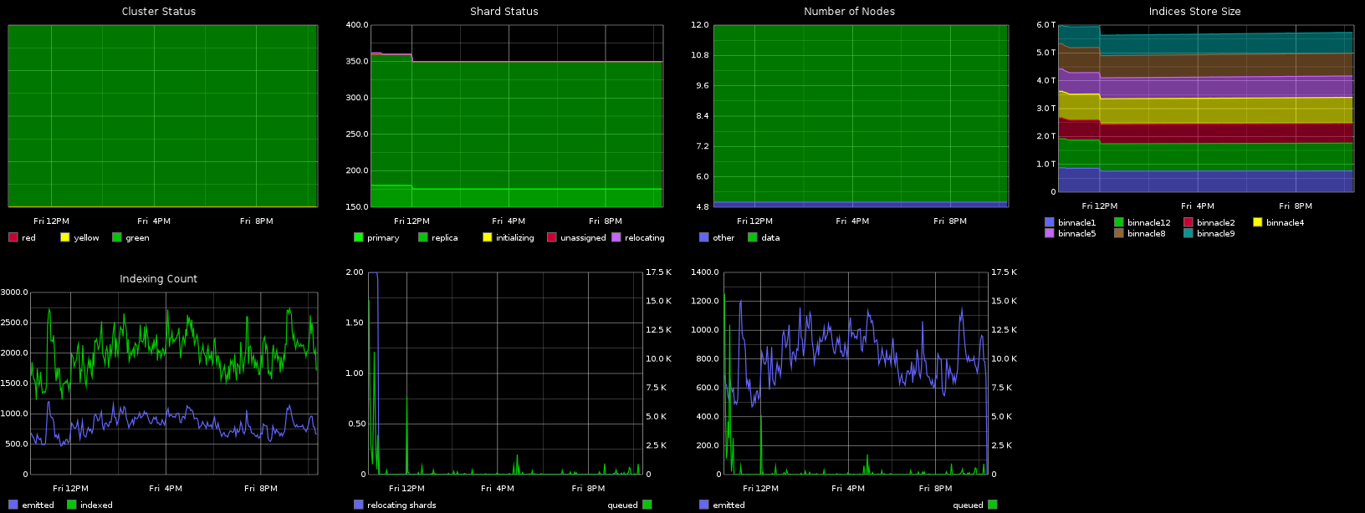
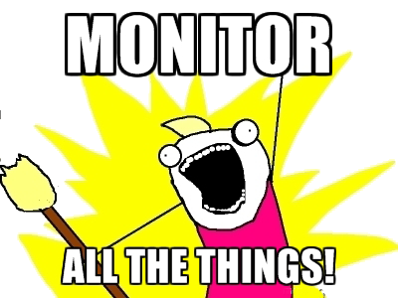
Notes:
MONITOR ALL THE THINGS!!
If your not monitoring the smallest of nodes in the solution, then you run the risk of loosing a jig-saw piece when you least expect it, just like any machine you need to look after all the moving parts as a whole collection, not just the parts your interested in.

Slide 18
Owin & Katana

Slide 19
Why Owin & Katana
In A Nut Shell
Because it’s an ideal way to create small, nimble and flexible services on ANY platform
Middleware
Cutting out the bloated overhead of things like “System.Web” and “System.Web.Mvc” and opting for a more streamlined middleware just works. Why do you think things like NodeJS are so successful?
Cross Platform
Owin is an “Open” standard, which means it’s available in the public domain for ANY platform provider to implement
Notes:
So why is Owin & Katana an important part of this emerging landscape?
The whole idea behind Owin and Katana is the exact ethos that surrounds that of the Microservice Architecture pattern.
Small, fast and efficient services that can be chained together to create larger applications.
Owin & Katana seek to remove bloated frameworks like system.web and replace them with an open ended flexible architecture that allows you the greatest of flexibility in your functional areas.
Because Owin is an open standard, it’s cross platform, services created on the windows platform, will run quite happily on Mono or under the various Xamarin ports for things like iOS and Android.
The standard is available in the public domain, so is not controlled by any one corporation, so there’s no nasty lock in's that might end up tying you down.

Slide 20
Why Owin & Katana
It’s already established in .NET and Linux
Katana is Microsoft’s implementation of the Owin standard. It’s also already available on the Linux/Unix platform as an Apache 2 module called “NoWin”
Many toolkits already support it
Web-API, NancyFX, OpenStack and many more already understand the interface semantics so can already work ahead of the .NET vNext strategy
You DON’T need a web server
Just as NodeJS can spin up a service endpoint without a web server, so can Owin and it’s related family
Notes:
The open source nature of Owin means that it’s already established elsewhere.
Katana is just Microsoft’s implementation of the standard. “NoWin” has been available and used in production on Apache2 under Linux and Unix systems for quite some time now.
The best part about it all however, is that it’s not just Microsoft that support it.
Myself personally for example, I absolutely love using the “NancyFX” framework for .NET, and NancyFX fully supports the Owin standard way of doing things, openstack and the MS Web-API are two others that already do too.
NancyFX runs unmodified on Mono under Linux and Unix, which means as .NET developers we can now do something that Java has been doing for a very long time, and that’s write once, run anywhere.
I recently wrote a book on using NancyFX for the succinctly Ebook series available from Syncfusion, which is scheduled to be released next month (November 2015), in this book I use a phase coined by a good friend of mine:
“NancyFX, that’s that toolkit that’s a bit like NodeJS for C# isn’t it?”
A statement that couldn’t be any more accurate, because just like NodeJS, Nancy and all of these frameworks that support Owin can create their own hosting layer just as easily as they can support existing web server hosting layers.

Slide 21
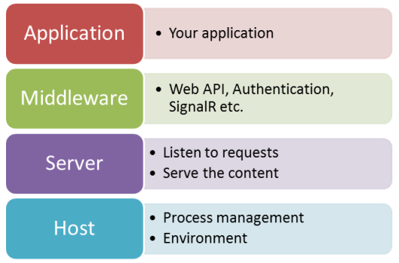
Owin is Modular
Notes:
This modular architecture, means that the services you build to support your Microservice pattern maintain their light weight and speed very simply by cutting out the excess baggage that they don’t need.
As you saw earlier, it’s this excess baggage that contributes to the overall bulk that makes up a large portion of the monolithic behemoth that we’ve come to know in most web application architectures.

Slide 22
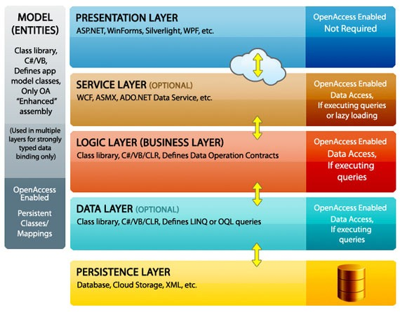
Owin is Layered
Notes:
Where all familiar with typical N-Tier application design, where we break our projects into layers.
In the .NET world this often means that we separate out our services into class libraries, which are then brought into our web/UI layer, often using some kind of IOC container.
With Owin and the use of the Microservice pattern, you can now go one step further and fully separate out your entire layer into it’s own fully decoupled service.
Your cross cutting concerns become “Authentication Services” and “Communication Bus Services” that are accessible by all components.
Your “Data Layer” becomes your “Data Service” and can be replicated at will and then load balanced to meet periods of intense database activity, each department in your organisation can have it’s own “Business Rules” service, meaning the knowledge of how those rules are interpreted stays only with the department that uses it.

Slide 23
Summary
Owin makes for a great platform to run services on
The choices you have extend to many different platforms and architectures from .NET to Apple
.NET is NOW Open source
Because .NET is now open source, the .NET ecosystem can be ported to anything that can build it, splitting up ASP.NET and the monolith that is System.Web into Owin pipeline modules is now easy
One Common Environment, a Million different possibilities
.NET truly is entering a new era of write once, run anywhere, i can now even run a full .NET stack on my Raspberry PI!

Slide 24
Summary
Deploying Microservices makes your development efforts more flexible
If you’re an Agile practitioner, wrap your functionality into Microservices and deploy to your sprint timelines
Microservices can be challenging
It’s not always going to be super easy, especially in the beginning, but once your running it’s plain sailing all the way.
Good Planning is the secret to success
Knowing what you want to achieve, and having an initial picture of how gives you a great head start.

Slide 25
Demo Time
Notes:
Ok, so with all that behind us I’m now going to spend a small amount of time showing you ONE possible implementation of this pattern using .NET

Slide 26
Demo Time
Code is available on my Git-Hub Page
Clone it from : https://github.com/shawty/DDDNorth2015
You cannot do this using IIS Express
Because of the nature of the way the demo works you MUST put this together under a full IIS Server, it won’t work on the express versions that ship with Visual Studio
You will need Application Request Routing added to IIS
Using IIS for this means you need the ARR (Application request routing) extension added, you can download it free at:
http://www.iis.net/downloads/microsoft/application-request-routing/

